Slide 1
Cooperative Q-learning for Rejection of Persistent Adversarial Inputs in Networked Linear Quadratic Systems
Author: Kyriakos G. Vamvoudakis and Joao P. Hespanha
Presenter: Murtaza Rangwala

Slide 2
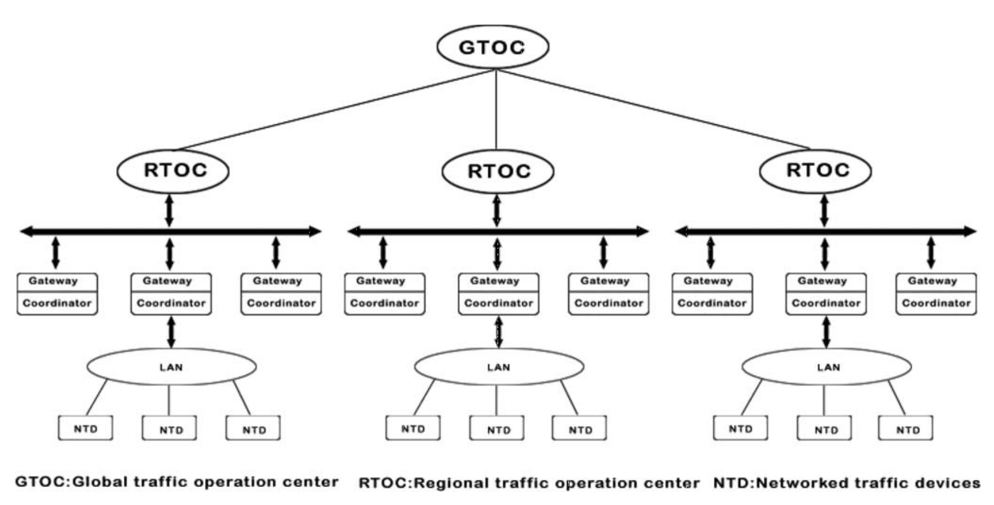
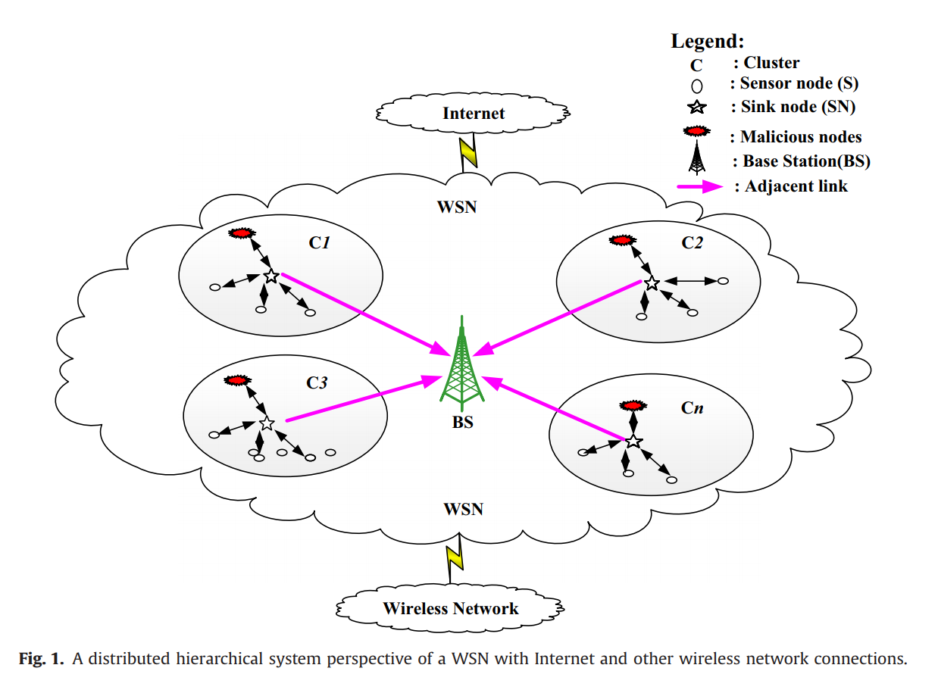
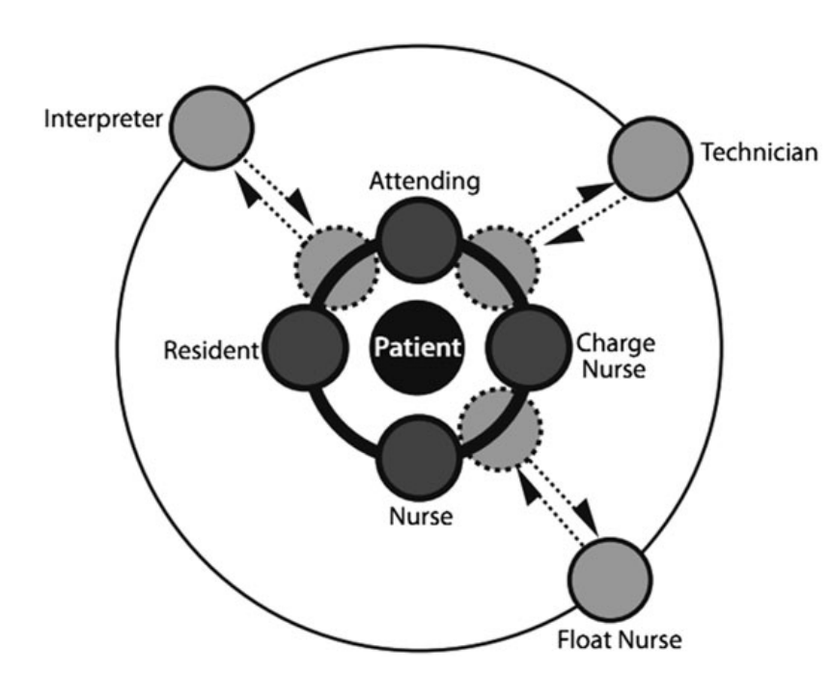
Large Networks with Complex Systems
Intelligent Transport Systems
Network Security: Hierarchical Routing
Collaboration of a Patient Care Team

Slide 3
Problems Addressed
Needs complete knowledge of the system to be controlled.
Q-Learning is well established only for discrete-time dynamics
State and action space, scales exponentially with number of agents
Computation time of convergence explodes due to large look-up tables for global action-pair values.

Slide 4


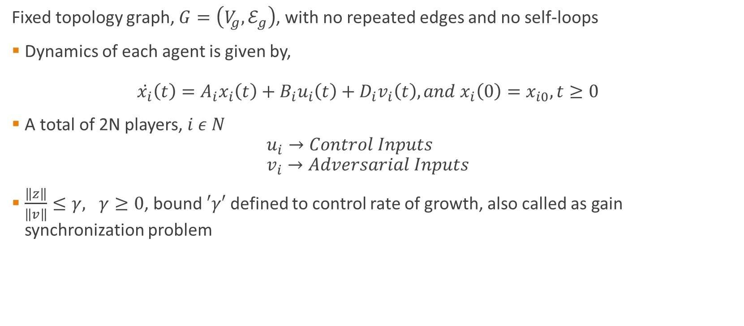



Formally,
$$\tilde{v}$$
V
$$v$$
P
$$z$$
$$u$$
$$y$$
Fixed topology graph, $G=\left(V_{g},ℰ_{g}\right)$, with no repeated edges and no self-loops
Dynamics of each agent is given by, $\dot{x_{i}}\left(t\right)=A_{i}x_{i}\left(t\right)+B_{i}u_{i}\left(t\right)+D_{i}v_{i}\left(t\right), and x_{i}\left(0\right)=x_{i0}, t≥0$
A total of 2N players, $i ε N$ $u_{i}→Control Inputs$ $v_{i}→Adversarial Inputs$
$\frac{\left\|z\right\|}{\left\|v\right\|}≤γ, γ≥0$, bound $′γ′$ defined to control rate of growth, also called as gain synchronization problem

Slide 5
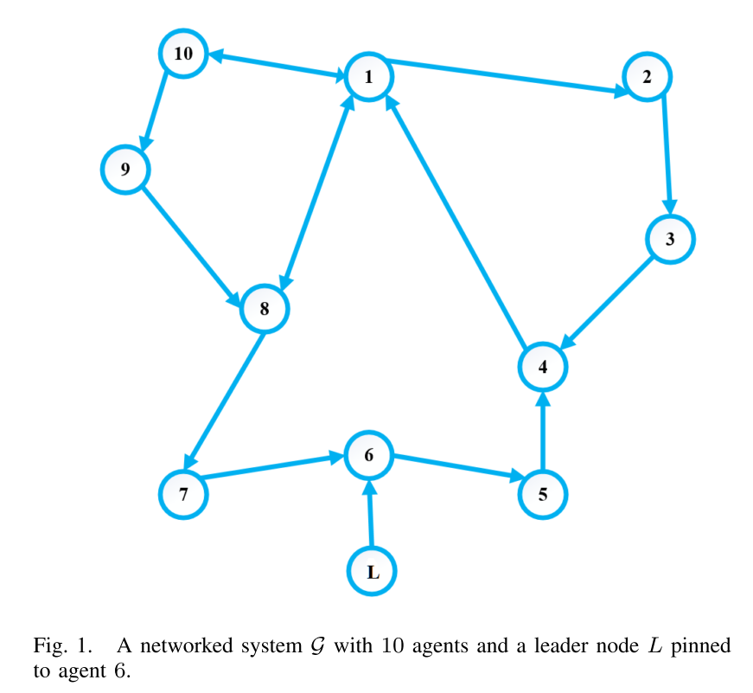
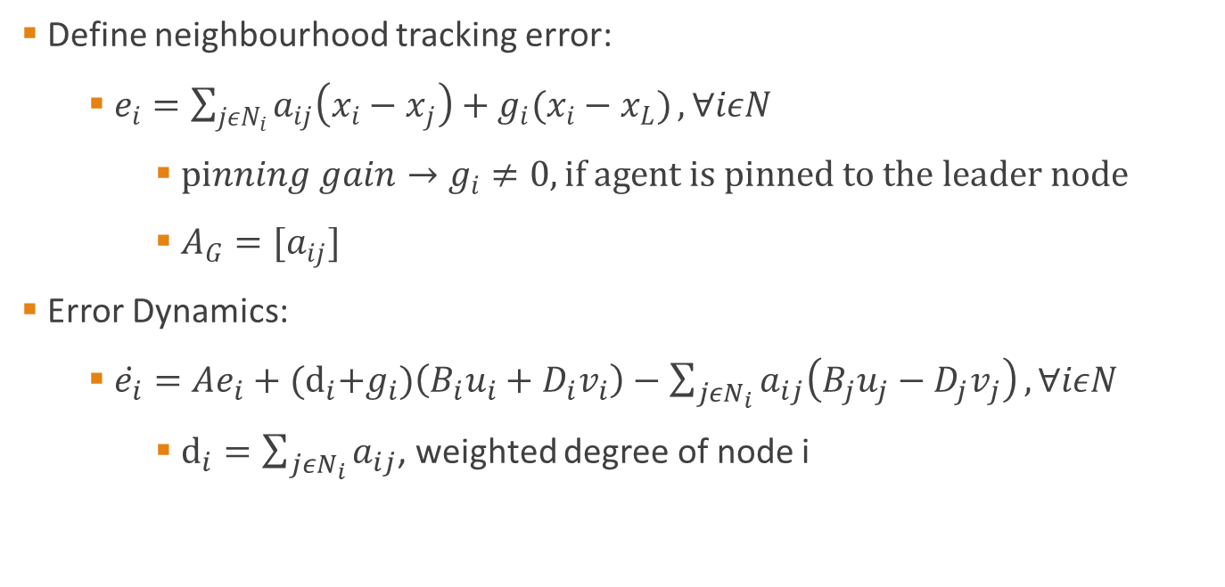
Problem Formulation
Define neighbourhood tracking error:
$e_{i}=\sum_{jεN_{i}}{a_{ij}\left(x_{i}−x_{j}\right)+g_{i}(x_{i}−x_{L})}, ∀iεN$
$pinning gain→g_{i}≠0, if agent is pinned to the leader node$
$A_{G}=[a_{ij}]$
Error Dynamics:
$\dot{e_{i}}=Ae_{i}+{(d}_{i}+g_{i})\left(B_{i}u_{i}+D_{i}v_{i}\right)−\sum_{jεN_{i}}{a_{ij}\left(B_{j}u_{j}−D_{j}v_{j}\right)}, ∀iεN$
$d_{i}=\sum_{jεN_{i}}{a_{ij}}$, weighted degree of node i

Slide 6
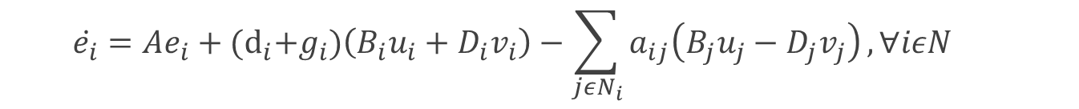
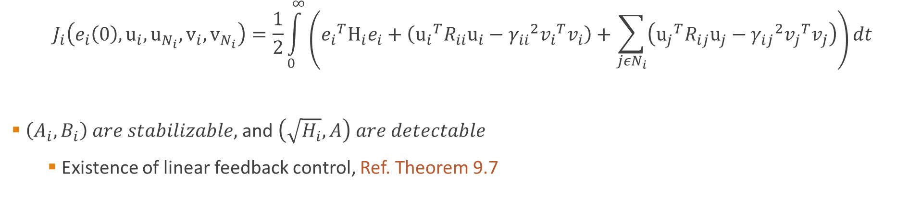
Cost Function for each Agent
Previously,
$$\dot{e_{i}}=Ae_{i}+{(d}_{i}+g_{i})\left(B_{i}u_{i}+D_{i}v_{i}\right)−\sum_{jεN_{i}}{a_{ij}\left(B_{j}u_{j}−D_{j}v_{j}\right)}, ∀iεN$$
$$J_{i}\left(e_{i}\left(0\right),u_{i},u_{N_{i}},v_{i},v_{N_{i}}\right)=\frac{1}{2}\int_{0}^{∞}{\left({e_{i}}^{T}H_{i}e_{i}+\left({u_{i}}^{T}R_{ii}u_{i}−{γ_{ii}}^{2}{v_{i}}^{T}v_{i}\right)+\sum_{jεN_{i}}{\left({u_{j}}^{T}R_{ij}u_{j}−{γ_{ij}}^{2}{v_{j}}^{T}v_{j}\right)}\right)dt}$$
$\left(A_{i},B_{i}\right) are stabilizable,$ and $\left(\sqrt{H_{i}},A\right) are detectable$
Existence of linear feedback control, Ref. Theorem 9.7

Slide 7
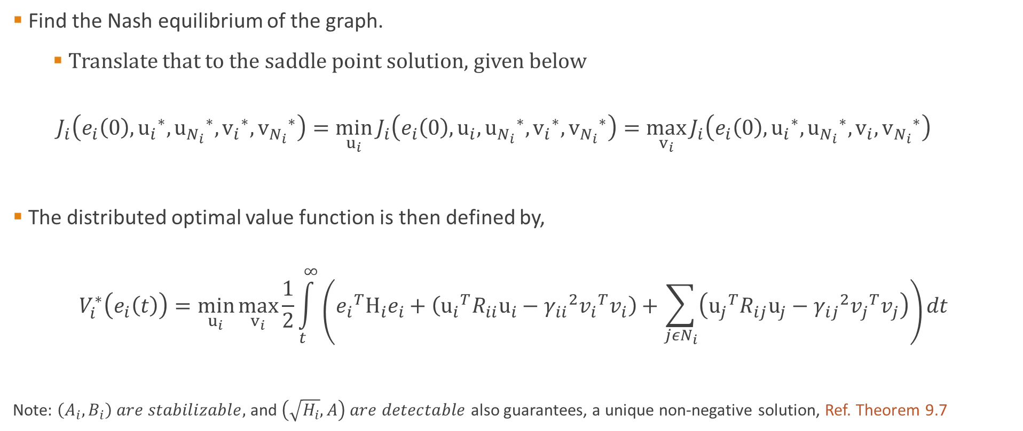

Saddle Point Solution
Find the Nash equilibrium of the graph.
Translate that to the saddle point solution, given below
$$J_{i}\left(e_{i}\left(0\right),{u_{i}}^{∗},{u_{N_{i}}}^{∗},{v_{i}}^{∗},{v_{N_{i}}}^{∗}\right)=\min_{u_{i}}{J_{i}\left(e_{i}\left(0\right),u_{i},{u_{N_{i}}}^{∗},{v_{i}}^{∗},{v_{N_{i}}}^{∗}\right)}=\max_{v_{i}}{J_{i}\left(e_{i}\left(0\right),{u_{i}}^{∗},{u_{N_{i}}}^{∗},v_{i},{v_{N_{i}}}^{∗}\right)}$$
The distributed optimal value function is then defined by,
$$V_{i}^{∗}\left(e_{i}\left(t\right)\right)=\min_{u_{i}}{\max_{v_{i}}{\frac{1}{2}\int_{t}^{∞}{\left({e_{i}}^{T}H_{i}e_{i}+\left({u_{i}}^{T}R_{ii}u_{i}−{γ_{ii}}^{2}{v_{i}}^{T}v_{i}\right)+\sum_{jεN_{i}}{\left({u_{j}}^{T}R_{ij}u_{j}−{γ_{ij}}^{2}{v_{j}}^{T}v_{j}\right)}\right)dt}}}$$
Note: $\left(A_{i},B_{i}\right) are stabilizable,$ and $\left(\sqrt{H_{i}},A\right) are detectable$ also guarantees, a unique non-negative solution, Ref. Theorem 9.7
Integral function of $J_{i}$
Notes:
$\left(\sqrt{H_{i}},A\right)$, guarantees that stabilizing control is generated naturally through the solution process

Slide 8
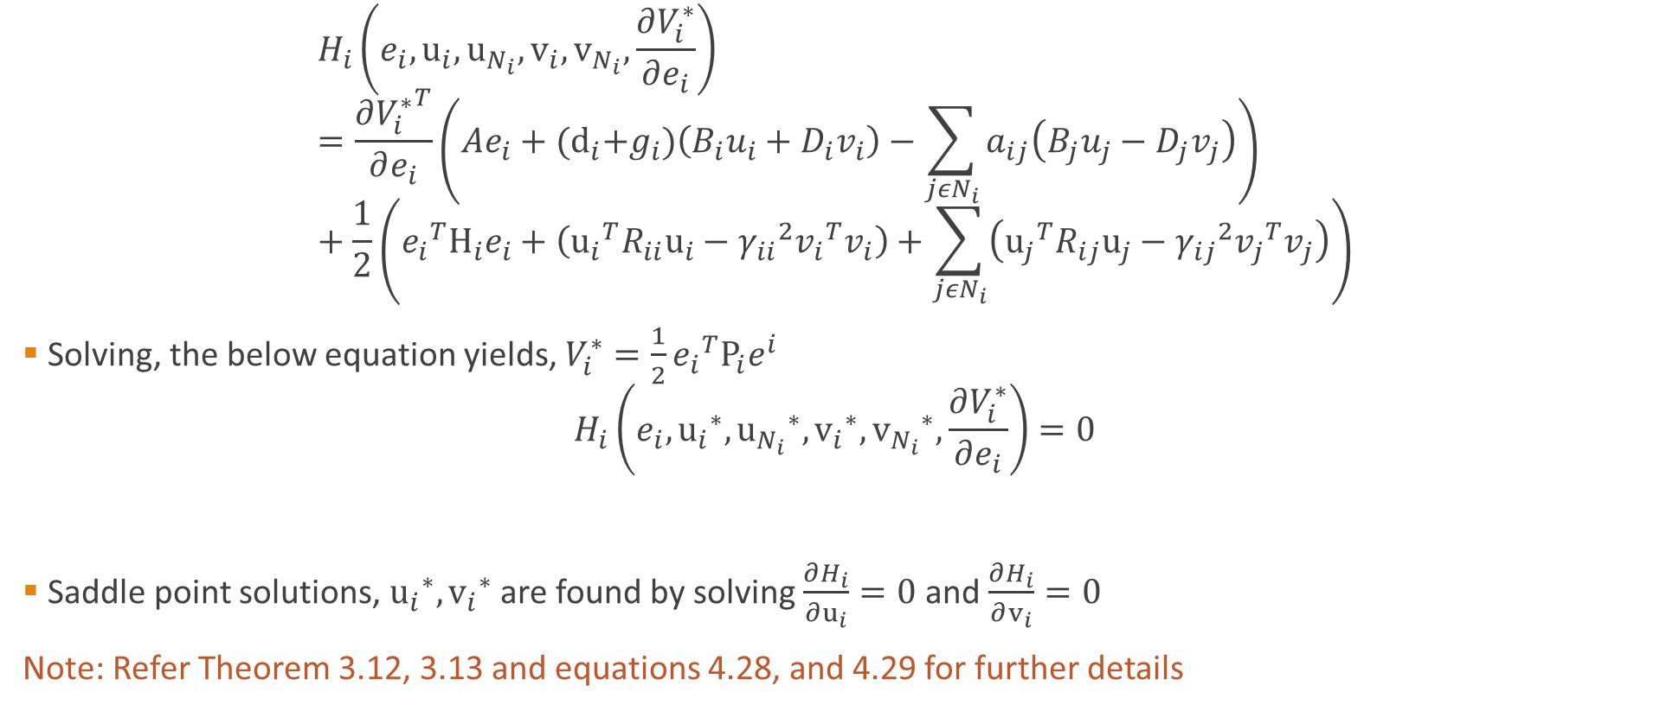


Hamilton-Jacobi Equations (HIGH Computation COST!!)
$$\dot{e_{i}}$$
$$H_{i}\left(e_{i},u_{i},u_{N_{i}},v_{i},v_{N_{i}},\frac{∂V_{i}^{∗}}{∂e_{i}}\right)=\frac{∂{V_{i}^{∗}}^{T}}{∂e_{i}}\left(Ae_{i}+{(d}_{i}+g_{i})\left(B_{i}u_{i}+D_{i}v_{i}\right)−\sum_{jεN_{i}}{a_{ij}\left(B_{j}u_{j}−D_{j}v_{j}\right)}\right)+\frac{1}{2}\left({e_{i}}^{T}H_{i}e_{i}+\left({u_{i}}^{T}R_{ii}u_{i}−{γ_{ii}}^{2}{v_{i}}^{T}v_{i}\right)+\sum_{jεN_{i}}{\left({u_{j}}^{T}R_{ij}u_{j}−{γ_{ij}}^{2}{v_{j}}^{T}v_{j}\right)}\right)$$
Solving, the below equation yields, $V_{i}^{∗}=\frac{1}{2}{e_{i}}^{T}P_{i}e^{i}$
$$H_{i}\left(e_{i},{u_{i}}^{∗},{u_{N_{i}}}^{∗},{v_{i}}^{∗},{v_{N_{i}}}^{∗},\frac{∂V_{i}^{∗}}{∂e_{i}}\right)=0$$
Saddle point solutions, ${u_{i}}^{∗},{v_{i}}^{∗}$ are found by solving $\frac{∂H_{i}}{∂u_{i}}=0$ and $\frac{∂H_{i}}{∂v_{i}}=0$
Note: Refer Theorem 3.12, 3.13 and equations 4.28, and 4.29 for further details
Integral function of $J_{i}$
Notes:
Double derivative of hi/ui, gives Rii>0, so it minimizes, and for hi/vi=-gama^2, so it maximizes.

Slide 9
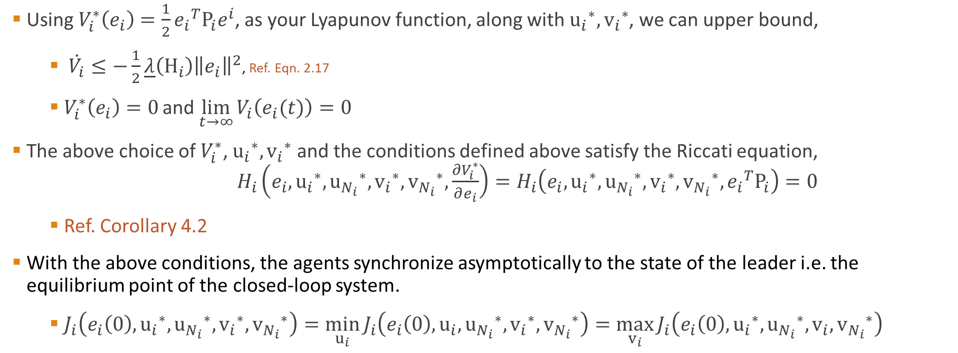
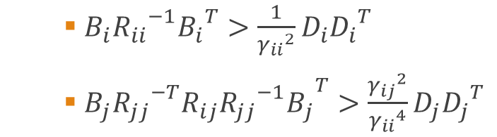
$B_{i}{R_{ii}}^{−1}{B_{i}}^{T}>\frac{1}{{γ_{ii}}^{2}}D_{i}{D_{i}}^{T}$
$B_{j}{R_{jj}}^{−T}{{R_{ij}{R_{jj}}^{−1}B}_{j}}^{T}>\frac{{γ_{ij}}^{2}}{{γ_{ii}}^{4}}D_{j}{D_{j}}^{T}$
Existence of Nash Equilibrium
Using $V_{i}^{∗}\left(e_{i}\right)=\frac{1}{2}{e_{i}}^{T}P_{i}e^{i}$, as your Lyapunov function, along with ${u_{i}}^{∗},{v_{i}}^{∗}$, we can upper bound,
$\dot{V_{i}}≤−\frac{1}{2}\underline{λ}\left(H_{i}\right){\left\|e_{i}\right\|}^{2}$, Ref. Eqn. 2.17
$V_{i}^{∗}\left(e_{i}\right)=0$ and $\lim_{t→∞}{V_{i}\left(e_{i}(t)\right)=0}$
The above choice of $V_{i}^{∗}$, ${u_{i}}^{∗},{v_{i}}^{∗}$ and the conditions defined above satisfy the Riccati equation, $H_{i}\left(e_{i},{u_{i}}^{∗},{u_{N_{i}}}^{∗},{v_{i}}^{∗},{v_{N_{i}}}^{∗},\frac{∂V_{i}^{∗}}{∂e_{i}}\right)=H_{i}\left(e_{i},{u_{i}}^{∗},{u_{N_{i}}}^{∗},{v_{i}}^{∗},{v_{N_{i}}}^{∗},{e_{i}}^{T}P_{i}\right)=0$
Ref. Corollary 4.2
With the above conditions, the agents synchronize asymptotically to the state of the leader i.e. the equilibrium point of the closed-loop system.
$J_{i}\left(e_{i}\left(0\right),{u_{i}}^{∗},{u_{N_{i}}}^{∗},{v_{i}}^{∗},{v_{N_{i}}}^{∗}\right)=\min_{u_{i}}{J_{i}\left(e_{i}\left(0\right),u_{i},{u_{N_{i}}}^{∗},{v_{i}}^{∗},{v_{N_{i}}}^{∗}\right)}=\max_{v_{i}}{J_{i}\left(e_{i}\left(0\right),{u_{i}}^{∗},{u_{N_{i}}}^{∗},v_{i},{v_{N_{i}}}^{∗}\right)}$
Notes:
Pi is unique symmetric positive definite matrices that solve the distributed coupled equations
Riccati equation - In infinite-horizon optimal control problems, one cares about the value of some variable of interest arbitrarily far into the future, and one must optimally choose a value of a controlled variable right now, knowing that one will also behave optimally at all times in the future.

Slide 10




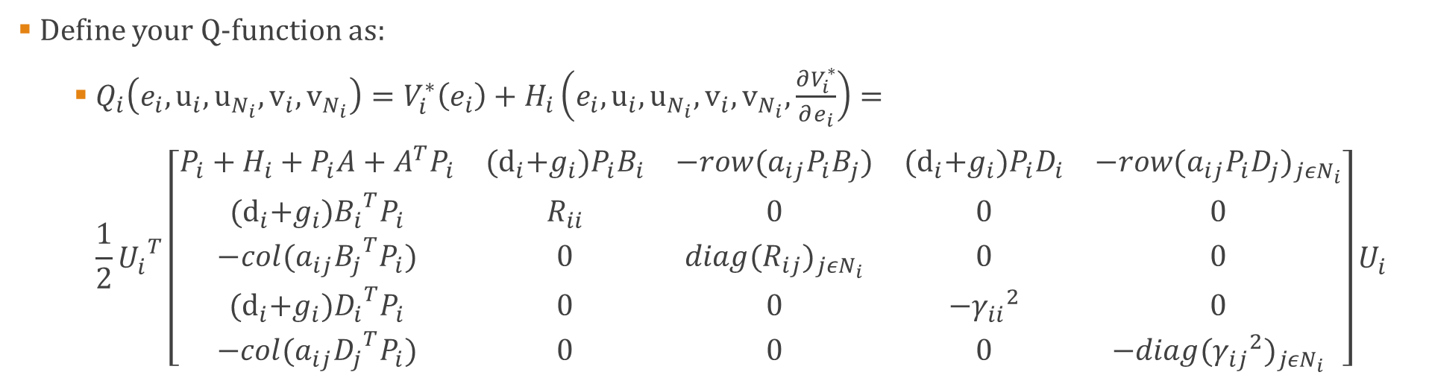






Advantage Function
Define your Q-function as:
$Q_{i}\left(e_{i},u_{i},u_{N_{i}},v_{i},v_{N_{i}}\right)=V_{i}^{∗}\left(e_{i}\right)+H_{i}\left(e_{i},u_{i},u_{N_{i}},v_{i},v_{N_{i}},\frac{∂V_{i}^{∗}}{∂e_{i}}\right)=$ $\frac{1}{2}{U_{i}}^{T}\left[\begin{matrix}P_{i}+H_{i}+P_{i}A+A^{T}P_{i} & {(d}_{i}+g_{i})P_{i}B_{i} & −row(a_{ij}P_{i}B_{j}) & {(d}_{i}+g_{i})P_{i}D_{i} & −row{(a_{ij}P_{i}D_{j})}_{jεN_{i}} \\ {(d}_{i}+g_{i}){B_{i}}^{T}P_{i} & R_{ii} & 0 & 0 & 0 \\ −col(a_{ij}{B_{j}}^{T}P_{i}) & 0 & diag{(R_{ij})}_{jεN_{i}} & 0 & 0 \\ {(d}_{i}+g_{i}){D_{i}}^{T}P_{i} & 0 & 0 & {−γ_{ii}}^{2} & 0 \\ −col(a_{ij}{D_{j}}^{T}P_{i}) & 0 & 0 & 0 & −diag{({γ_{ij}}^{2})}_{jεN_{i}}\end{matrix}\right]U_{i}$
$$e_{i}$$
$$u_{i}$$
$$u_{N_{i}}$$
$$v_{i}$$
$$v_{N_{i}}$$
$$e_{i}$$
$$u_{i}$$
$$u_{N_{i}}$$
$$v_{i}$$
$$v_{N_{i}}$$

Slide 11




Advantage Function
As part of Lemma 1, Nash Equilibrium is restated as:
$Q_{i}\left(e_{i},{u_{i}}^{∗},{u_{N_{i}}}^{∗},{v_{i}}^{∗},{v_{N_{i}}}^{∗}\right)=\min_{u_{i}}{Q_{i}\left(e_{i},u_{i},{u_{N_{i}}}^{∗},{v_{i}}^{∗},{v_{N_{i}}}^{∗}\right)}=\max_{v_{i}}{Q_{i}\left(e_{i},{u_{i}}^{∗},{u_{N_{i}}}^{∗},v_{i},{v_{N_{i}}}^{∗}\right)}$
Critic Approximator Weights
$Q_{i}\left(e_{i},{u_{i}}^{∗},{u_{N_{i}}}^{∗},{v_{i}}^{∗},{v_{N_{i}}}^{∗}\right)={W_{ic}}^{T}(U_{i}⨂U_{i})$
Control Actor Weights
${u_{i}}^{∗}\left(e_{i}\right)=\min_{u_{i}}{Q_{i}\left(e_{i},u_{i},u_{N_{i}},v_{i},v_{N_{i}}\right)}=−{\left({Q_{u_{i}u_{i}}}^{i}\right)}^{−1}\left({Q_{u_{i}e_{i}}}^{i}\right)e_{i}={W_{ia}}^{T}e_{i}$
Adversarial Actor Weights
${v_{i}}^{∗}\left(e_{i}\right)=\max_{v_{i}}{Q_{i}\left(e_{i},u_{i},u_{N_{i}},v_{i},v_{N_{i}}\right)}=−{\left({Q_{v_{i}v_{i}}}^{i}\right)}^{−1}\left({Q_{v_{i}e_{i}}}^{i}\right)e_{i}={W_{id}}^{T}e_{i}$
Find an estimate to the optimal
$$\hat{W_{ic}}$$
Find an estimate to the optimal
$$\hat{W_{ia}}$$
Find an estimate to the optimal
$$\hat{W_{id}}$$

Slide 12





Gradients to estimate Weights ‘W’
$$0$$
$${\hat{W}}_{ia}^{T}e_{i}$$
$$E_{i}=\hat{W_{ic}}\left(U_{i}⨂U_{i}\right)+\frac{1}{2}\int_{t−T}^{t}{\left({e_{i}}^{T}H_{i}e_{i}+\left({\hat{u}}_{i}^{T}R_{ii}{\hat{u}}_{i}−{γ_{ii}}^{2}{\hat{v}}_{i}^{T}{\hat{v}}_{i}\right)+\sum_{jεN_{i}}{\left({\hat{u}}_{j}^{T}R_{ij}{\hat{u}}_{j}−{γ_{ij}}^{2}{\hat{v}}_{j}^{T}{\hat{v}}_{j}\right)}\right)dt−\hat{W_{ic}}\left(U_{i}(t−T)⨂U_{i}(t−T)\right)}$$
$$E_{ia}={\hat{W}}_{ia}^{T} e_{i}+{\left({\hat{Q}}_{u_{i}u_{i}}^{i}\right)}^{−1}\left({\hat{Q}}_{u_{i}e_{i}}^{i}\right)e_{i}$$
$$E_{id}={\hat{W}}_{id}^{T} e_{i}+{\left({\hat{Q}}_{v_{i}v_{i}}^{i}\right)}^{−1}\left({\hat{Q}}_{v_{i}e_{i}}^{i}\right)e_{i}$$
Define squared-norm errors as, $K_{im}=\frac{1}{2}{\left\|E_{im}\right\|}^{2}$
$${\dot{\hat{W}}}_{im}=−α_{im}\frac{dK_{im}}{d\hat{W_{im}}}$$
Pick from $\hat{W_{ic}}$
Pick from $\hat{W_{ic}}$
Notes:
also known as a dynamic programming equation, is a necessary condition for optimality associated with the mathematical optimization method known as dynamic programming. It writes the value of a decision problem at a certain point in time in terms of the payoff from some initial choices and the value of the remaining decision problem that results from those initial choices

Slide 13
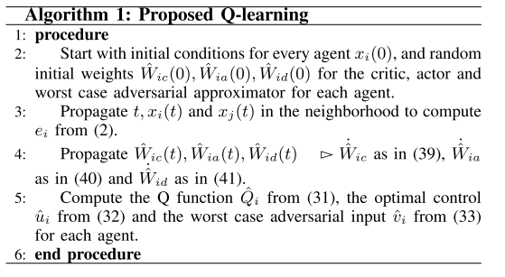

Slide 14
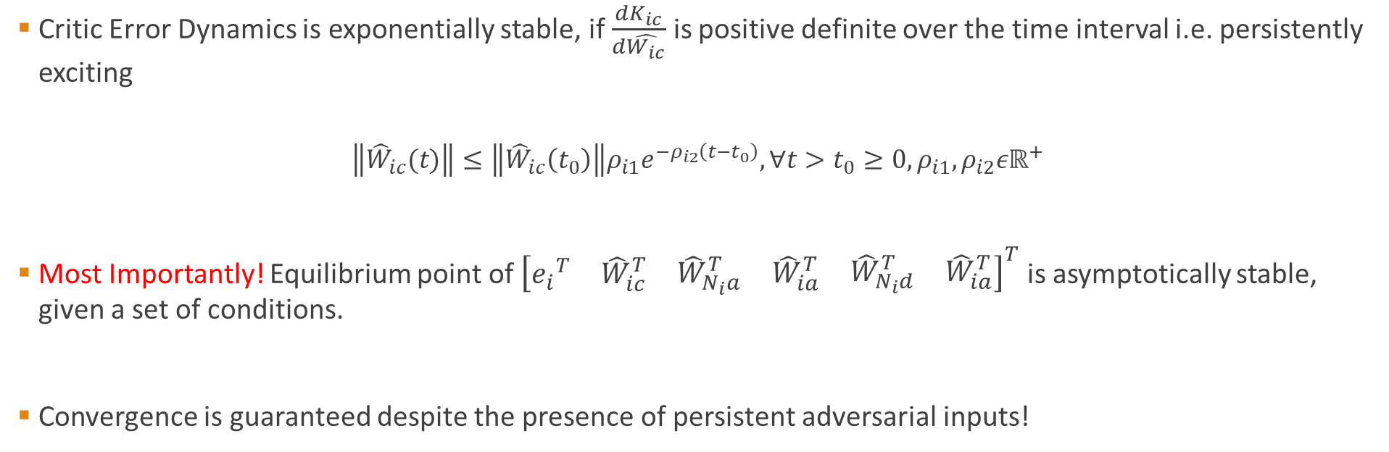
Stability Guarantee
Critic Error Dynamics is exponentially stable, if $\frac{dK_{ic}}{d\hat{W_{ic}}}$ is positive definite over the time interval i.e. persistently exciting
$$\left\|{\hat{W}}_{ic}(t)\right\|≤\left\|{\hat{W}}_{ic}\left(t_{0}\right)\right\|ρ_{i1}e^{−ρ_{i2}\left(t−t_{0}\right)}, ∀t>t_{0}≥0,ρ_{i1},ρ_{i2}εℝ^{+}$$
Most Importantly! Equilibrium point of ${\left[\begin{matrix}{e_{i}}^{T} & {\hat{W}}_{ic}^{T} & \begin{matrix}{\hat{W}}_{N_{i}a}^{T} & {\hat{W}}_{ia}^{T} & \begin{matrix}{\hat{W}}_{N_{i}d}^{T} & {\hat{W}}_{ia}^{T}\end{matrix}\end{matrix}\end{matrix}\right]}^{T}$ is asymptotically stable, given a set of conditions.
Convergence is guaranteed despite the presence of persistent adversarial inputs!

Slide 15
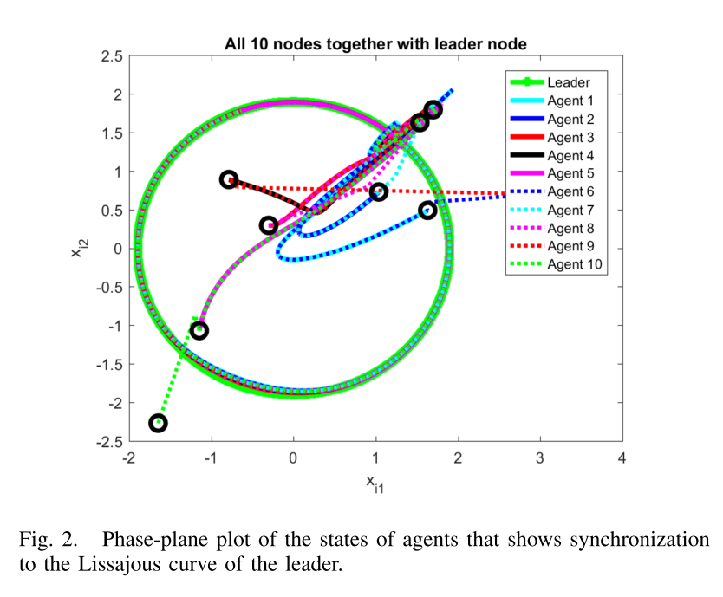
Experimental Results
Notes:
It is a graph of system of parametric equations, x=Asin(wt+delta), i.e. complex harmonic motion

Slide 16
Related Work
Approximate optimal cooperative decentralized control for consensus in a topological networks of agents with uncertain nonlinear dynamics, Kamalapurkar et al., American Control Conference, 2013
Future Work
Extend results to non-linear systems
Identify a framework to extend the work to a hierarchical reinforcement learning platform

